Slide 1

G2M Insight for Cab Investment
21/6/2022

Slide 2
Agenda
Executive Summary
Problem Statement
Approach
EDA
EDA Summary
Recommendations

Slide 3
Background Information
• Company XYZ is a private equity firm in US that intends investing in the Cab industry due to the recent remarkable growth the Cab Industry witnessed and the presence of multiple key players in the market.
Objective: Provide actionable insights to assist XYZ in identifying the right company for making investment.
The analysis has been divided into four parts:
• Data Understanding
• Forecasting profit and number of rides for each cab type
• Finding the most profitable Cab company
• Recommendations for investment

Slide 4
Data Preprocessing and Preparation
Four datasets were made available for the process:
Cab_Data: This dataset includes information about two cab companies in the industry.
Customer_ID: This contains demographic information about the customers with unique identifiers.
Transaction_ID: this contains transaction information like payment mode and customer mapping
City: This file contains US cities information like population and cab users.

Slide 5
Data Structure Analysis

Slide 6
The complete data contains 359392 observations and 16 variables which include categorical and numerical variables.
Data date: ranges from 08/01/2016 to 02/01/2018.
Gender: Male and Female.
Payment Method: Card and Cash.
KM_Travelled: between 1.9 to 48.0.
Price Charged: between 15.6 to 2048.03.
Cost of Trip: between 19.0 to 691.2.
Age: between 18 to 65.
Income: between 2000 to 35,000.
Population: between 248968 to 8405837.
Cab Users: between 3643 to 302149.
Cab Company: Yellow Cab & Pink Cab

Slide 7
Exploratory Data Analysis

Slide 8
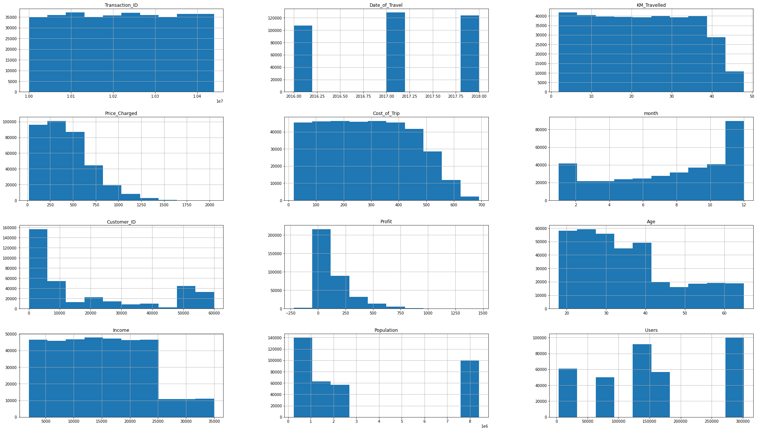
Distribution of Variables in the Complete Data
We can see that all the numerical variables in the data are not uniformly distributed

Slide 9
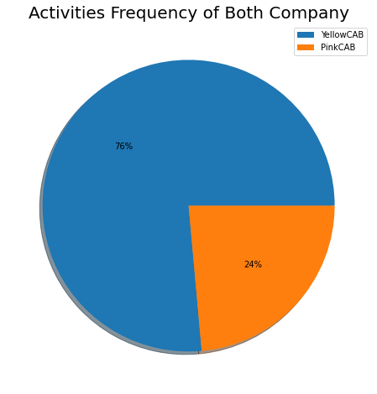
Percentage Activities of the Two Cab Companies
The Pie chart shows that the Yellow Cab company holds a larger share (76%) of activities in the data while the Pink Cab company accounted for only 24%

Slide 10
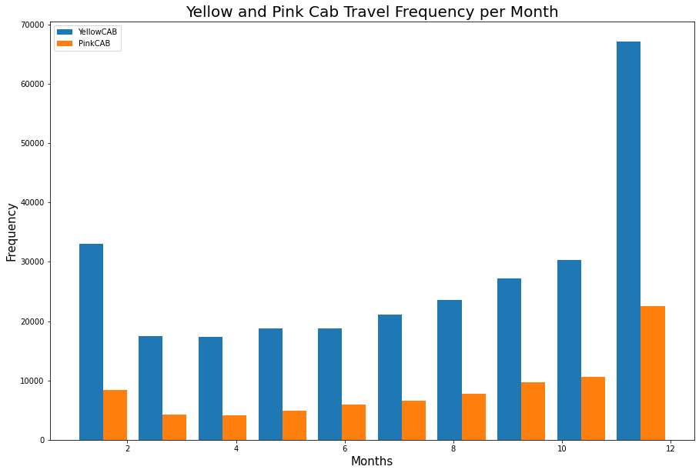
Distribution of Cab Companies’ Activities Across Months
The Yellow Cab company was involved in more activities than the Pink Cab company in various months throughout the year. December and January have the highest distribution of activities for both companies.

Slide 11
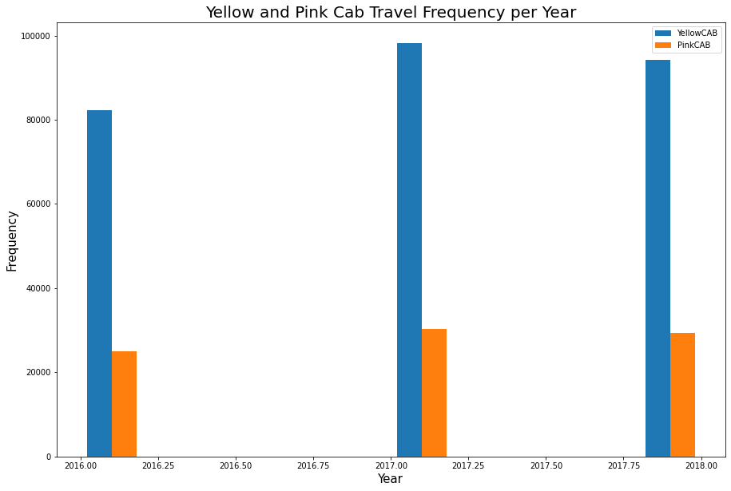
Distribution of Cab Companies’ Activities Across Years
The Yellow Cab company was involved in more activities that the Pink Cab company in the three years. Year 2017 has the highest distribution of activities for both companies.

Slide 12
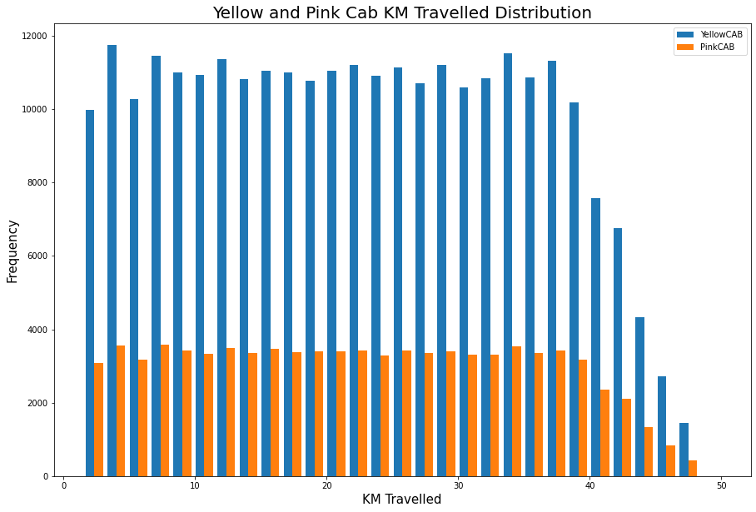
Distribution of KM Travelled by the Two Cab Companies
The Yellow Cab company travelled is more kilometers than the Pink Cab company. For both companies, the travelled distance ranges from 2 to 48 km.

Slide 13
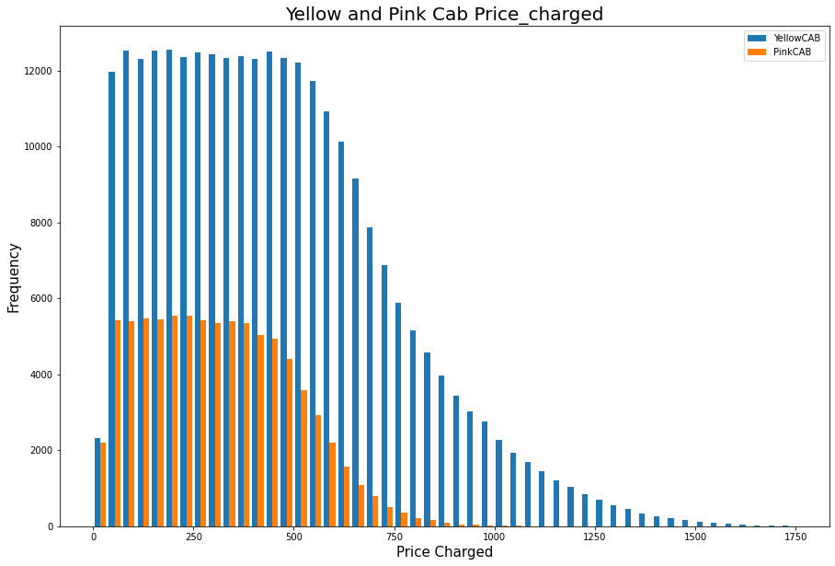
Distribution of Price Charged by the Two Cab Companies
The Yellow Cab charges is more than the Pink Cab company. For both companies, their charges ranges between 0 and 1750 usd with most representation around 0 to 500 usd.

Slide 14
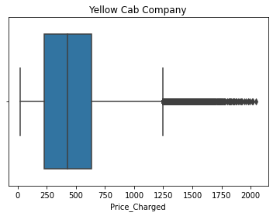
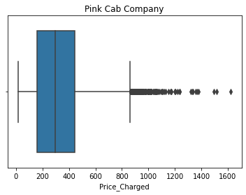
Distribution of Price Charged by the Two Cab Companies
The Yellow Cab price charged range is more than the Pink Cab company’s. Both companies’ price charges has outliers, and this could be because of the few longer distance travelled.

Slide 15
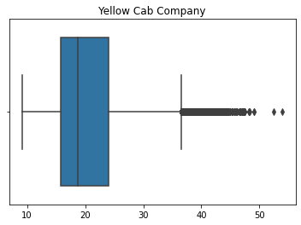
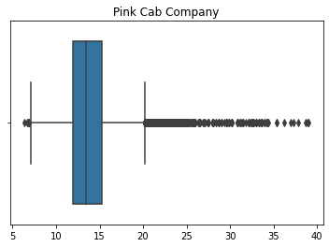
Distribution of Price Charged by the Two Cab Companies per KM
The Yellow Cab charged between 10 and 60 usd per km while the Pink Cab charges between 7 and 40 usd. This is evident that the Yellow Cab charges more than the Pink Cab per Km.

Slide 16
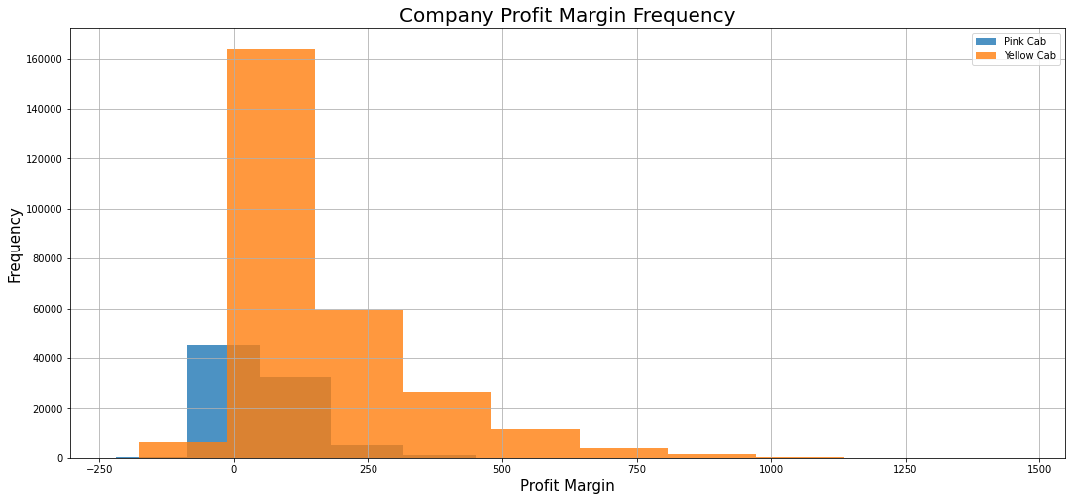
Distribution of Profit Margin by the Two Cab Companies
According to the chart, the Yellow Cab charged made lesser losses than the Pink Cab Company. On the other side, the Yellow Cab makes more profit than the Pink Can company.
Profit Margin = Price Charged – Cost of Trip.

Slide 17
Result Comparison Between Yellow Cab and Pink Cab’s Data
 | Total Profit | Avg. Price Charged per KM | Total Users | Returning Customers
Yellow Cab | 44,020,373. | 20.3 | 46,276,399,954 | 27,865
Pink Cab | 5,307,328 | 13.8 | 10,638,923,388 | 17,996

Slide 18
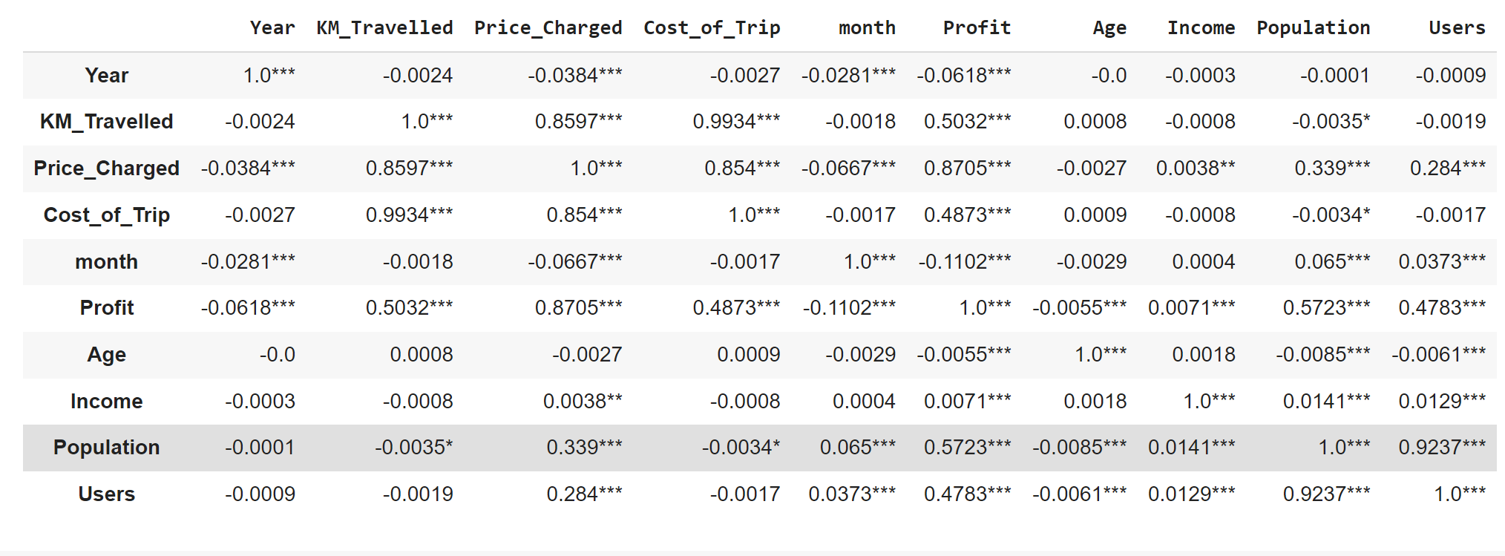
Yellow Cab Company’s Numeric Variables Correlation Analysis
The table show variables that are correlated in the Yellow Cab company’s data

Slide 19
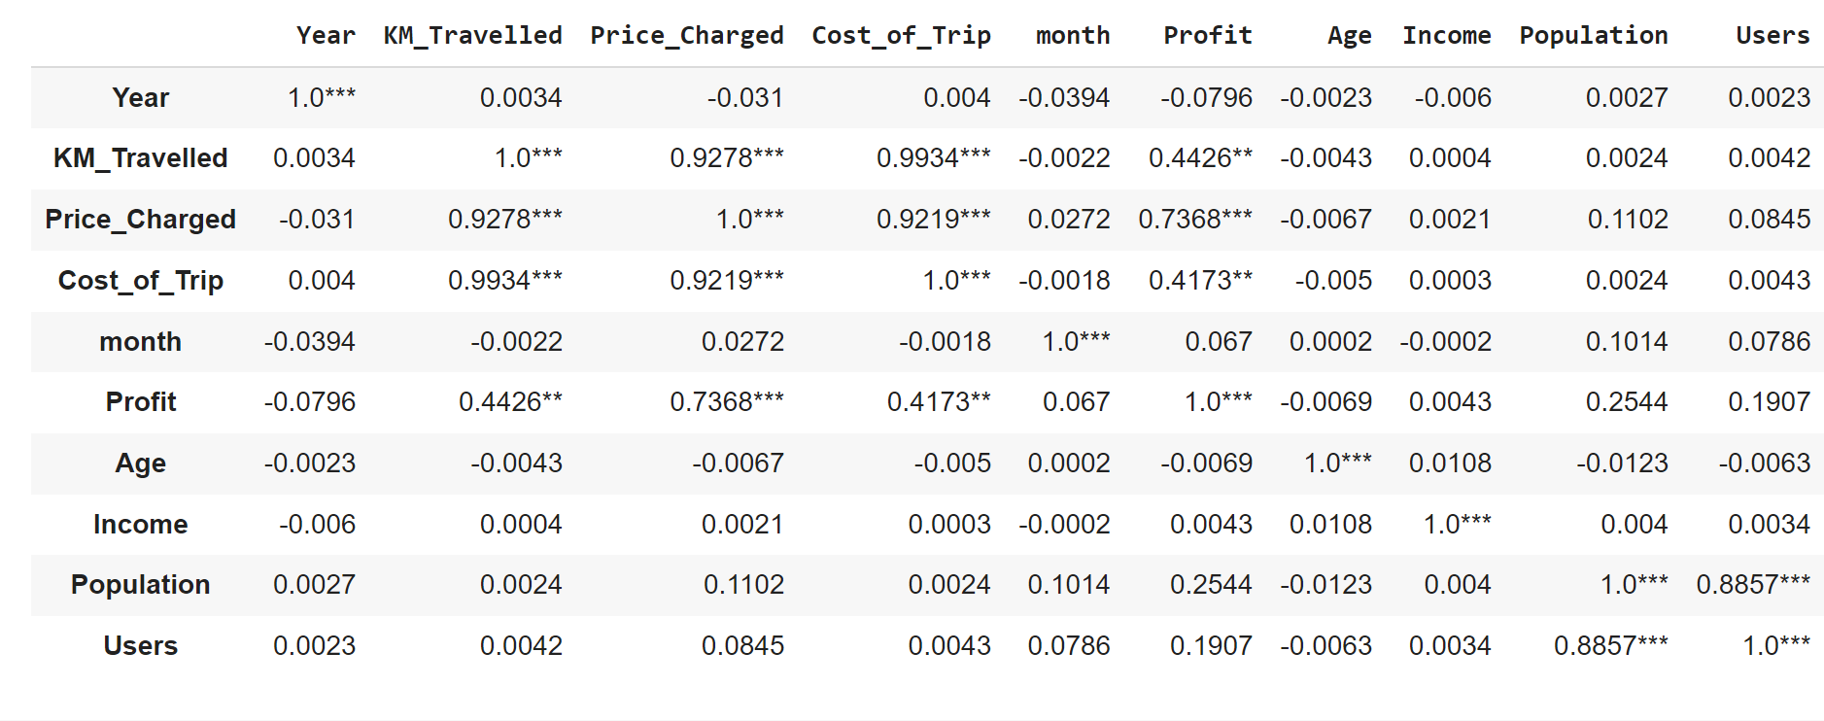
Yellow Cab Company’s Numeric Variables Correlation Analysis
The two correlation tables indicates that unlike the Yellow Cab company, Price Charged and Profit are not correlated with Year and Month in the Pink Cab company data

Slide 20
Results and Discussion

Slide 21
Yellow Cab
Pink Cab
Yellow Cab accounted for 76% of all the travel activities in the data
Pink Cab accounted for 24% of all the travel activities in the data
Yellow Cab Price Charged ranges from $20.7 to $2048
Pink Cab Price Charged ranges from $15.6 to $1623
Yellow Cab Price Charged between $9 to $58 per kilometer
Pink Cab Price Charged between $5 to $40 per kilometer
Yellow Cab profits ranges between $-176 to $1,463 per kilometer
Pink Cab profits ranges between $-220 to $1,119 per kilometer
Yellow Cab total profit is 44,020,373
Pink Cab total profit is 5,307,328
Yellow Cab Avg. price charge per km is 20.3
Pink Cab Avg. price charged per km is 13.8
Yellow Cab total users is 46,276,399,954
Pink Cab total users is 10,638,923,388
Yellow Cab returning customers is 27,865
Pink Cab returning customers is 17,996

Slide 22
Hypothesis Testing

Slide 23
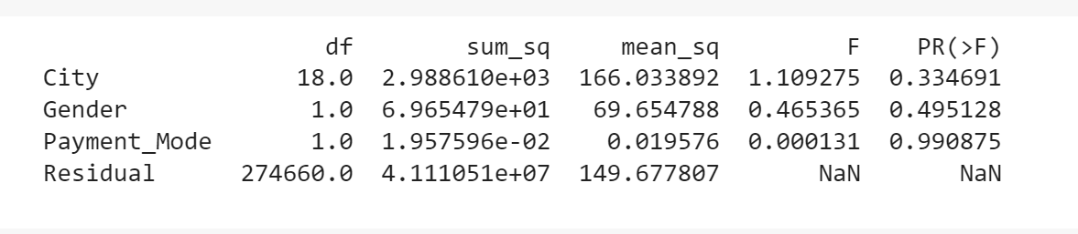
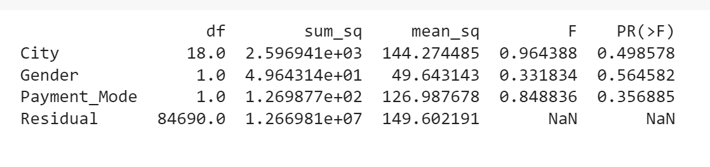
Hypothesis: there is no significant difference in the effect of each group in variables ‘City, Gender, Payment Mode on KM Travelled
Yellow Cab Company
Pink Cab Company
For the three variables City, Gender and Payment mode, we fail to reject the null hypothesis that there is significant difference in the effect each group in the variables on KM Travelled.

Slide 24
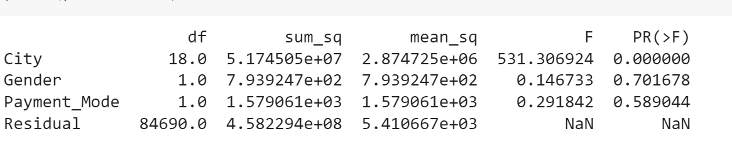
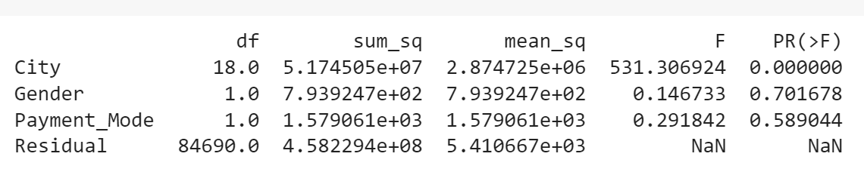
Hypothesis: there is no significant difference in the effect of each group in variables ‘City, Gender, Payment Mode on Profit
Yellow Cab Company
Pink Cab Company
For the variables Gender and Payment mode, we fail to reject the null hypothesis that there is significant difference in the effect each group on the variables on Profit made by the two companies. However, there is variation in the effect of the groups in variable City of the profit made. Hence, profits made by both companies will vary across the cities.

Slide 25
Recommendation
Customer Reach : The Yellow cab company has higher customer reach than Pink cab.
We observed that Yellow cab company has more returning customers than the Pink Cab company
It was observed that the Yellow Cab company charges more and makes more profit per KM travelled than the Pink Cab Company
Yellow Cab company travelled more distance than the Pink Cab company and the former accounted for more activities than the latter in the data.
Based on the prediction made, both companies will witness loss in profit. However, the Yellow cab company will get lesser loss (0.002%) compared to the Pink Cab company (-0.0052).
On the basis of above point , we will recommend Yellow cab for investment.

Slide 26
Thank You

